Slide 1



TRANSFORMING BALERICA INC’S
GLOBAL TESTING PLATFORM
GOOGLE CLOUD MIGRATION
ARMAGEDDON PROJECT | CLASS 6.5
LEAD CONSULTANT: JAMES SCALES

Slide 2

INTRODUCTION
Google Cloud Platform (GCP) delivers secure, automated infrastructure that reduces operational overhead and accelerates innovation. By leveraging its global network and managed services, businesses can replace costly, and time consuming maintenance with scalable, resilient growth.
This presentation outlines our strategy to modernize Balerica's infrastructure using Google Cloud. We will leverage GCP's managed services to create a secure, automated hybrid environment that meets your global business and technical requirements.

Slide 3
CURRENT STATE
Industry = Educational services (IT education, basic computing courses, certification testing center)
Location = Sao Paulo
Tech Stack
30 Lenovo M90 Gen 5 desktops purchased in 2024, with provided mouse, keyboard, webcam, headphones, and HP 24" monitor.
3rd party applications hosted on VMWare VMs (Linux and Windows 2016)
Homegrown secure exam browser built in Java, HTML, CSS, and VBScript
Backups hosted on premises; backups are done on a best effort basis
3 TP-Link unmanaged switches
Workflow
Click ops; (almost) all administration is done manually
Applications deployed via CMD scripts
No central codebase
Factory Lenovo image used when (re)imaging desktops
Test proctor launches secure browser before applicant sits down to start the exam, and fixes the browser if applicant experiences issues

Slide 4
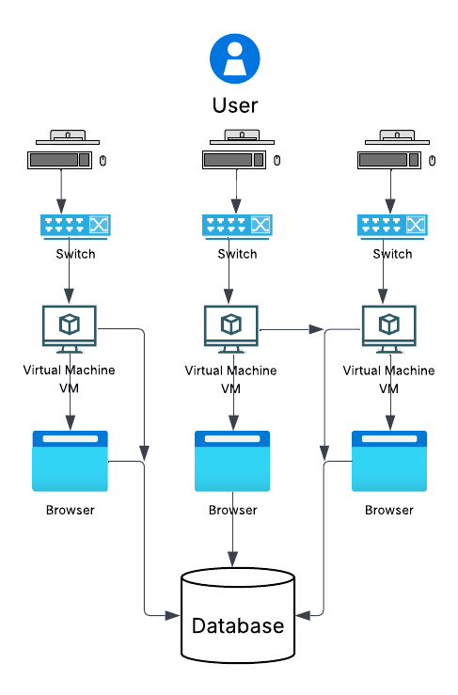
CURRENT STATE | DIAGRAM
Industry = Educational services (IT education, basic computing courses, certification testing center)
Location = Sao Paulo
Tech Stack
30 Lenovo M90 Gen 5 desktops purchased in 2024, with provided mouse, keyboard, webcam, headphones, and HP 24" monitor.
3rd party applications hosted on VMWare VMs (Linux and Windows 2016)
Homegrown secure exam browser built in Java, HTML, CSS, and VBScript
Backups hosted on premises; backups are done on a best effort basis
3 TP-Link unmanaged switches

Slide 5
MAIN GOALS
(+ Recommendations)
Headquartered in Sao Paulo, Balerica Inc. is looking to leverage public cloud technologies and services to expand their presence in their target markets.
Automate as much as possible
Reduce amount of click-ops
Centralize codebase
Enable remote control capabilities on desktops from administrators only
Cut down on desktop reimaging times & occurrences
Create a lightweight, scalable, secure browser for certification tests that rivals Pearson VUE.
Testing center in 5 countries (USA, Brazil, Japan, Italy, and Thailand/Phillippines)
Have network infrastructure that connects testing centers to each other, and administrators to the testing centers. communications MUST be as secure and redundant as possible.
Let robots handle the heavy lifting with workflows that scale and heal themselves!
Swap endless clicking with magic 'blueprints' that do the job for you.
One fortress of truth, safe and sound.
Peek into and command desktops from any corner of the globe, securely!
Cloud wizardry means fixing a borked machine is now a quickie, not a marathon.
Give the exam browser a shiny new web app makeover.
Host exam platforms close to home with Google Cloud hubs popping up in each country.
Zoom across a private, encrypted network superhighway between locations!

Slide 6
MAJOR PAIN POINTS
TOP 3
Manual Workflow (Click-Ops)
Manual processes are error-prone, costly, and impossible to scale. This creates significant business bottlenecks, slows down operations, and requires extensive staff training.
Our strategy automates wherever possible. By leveraging Google Cloud's automation tools, we ensure consistent, efficient deployments and free your team to focus on innovation, not routine maintenance. We will build a system that provisions resources almost instantly and can update code the codebase reliably.
Manual Re-Imaging and Launching of Exam Browser
This pain point is the most visible for company as it directly affects the customer experience. No customer wants to show up on exam day to take possibly a life-changing exam and experience an outage. This can quickly turn into loss of business if this issue happens frequent enough. We do also know mistakes and disasters happen!
Our strategy is to create a happy balance in reliable connection and being ready when the inevitable happens. Google Cloud has a reliable network minimizes disruptions and when disruptions happen resources are automatically spun up almost instantly

Slide 7
MAJOR PAIN POINTS
TOP 3
No Security or Compliance Governance
There is no mention of a security and there are processes and tools that are unmanaged. This model is a hidden liability. A single data breach or compliance failure could severely damage the company’s reputation and jeopardize the entire business. With the goal of scaling and creating bases in different countries creating a secure foundation will be vital for business success.
Our solution builds security into the foundation. Using Google Cloud’s enterprise-grade governance tools, we will centralize control, encrypt data end-to-end, and ensure audit-ready compliance—protecting your brand and your candidates’ trust.

Slide 8
FUTURE STATE | SUMMARY
This strategy migrates your on-premises infrastructure to a secure, automated Google Cloud platform. It uses Chrome Enterprise to convert existing desktops into cloud-managed kiosks, slashing reimaging time. Compute Engine with Managed Instance Groups hosts your legacy VMs for self-healing availability, while the modern exam browser is built on Cloud Run for automatic, cost-efficient scaling. All components connect through a global VPC with Cloud Interconnect for secure, low-latency access.
The key advantages are complete automation, eliminating manual "click-ops" via Cloud Build and Terraform; robust security enforced by Secret Manager, Cloud IAM, and Cloud Armor; and inherent global scalability. This results in a dramatic reduction in IT overhead, a resilient testing experience for applicants, and a foundation for continuous innovation.

Slide 9
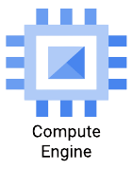
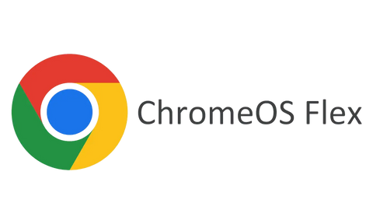
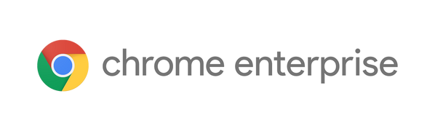
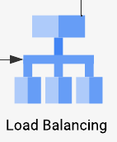
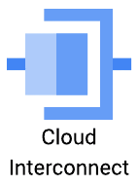
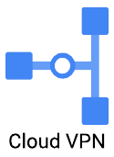
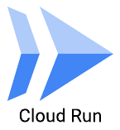
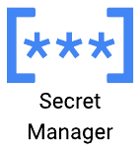
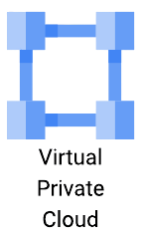
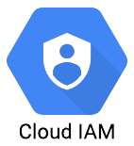
RECOMMENDED GCP & CI/CD SERVICES
Compute Engine
ChromeOS Flex + Chrome Entreprise
Provides secure, scalable virtual machines to run both Linux and Windows workloads, enabling a direct "lift-and-shift" migration from on-premises
Converts existing Lenovo desktops into secure, cloud-managed kiosks. Allows for central policy enforcement, instant remote control, and reimaging in minutes instead of hours.
Load Balancing
Cloud Interconnect or Cloud VPN
The Load Balancer automatically directs each incoming user request to a healthy VM instance in the MIG that is closest to them or has the most available capacity.
Establishes dedicated, private network connections from your on-premises locations (testing centers) to Google's network, ensuring low latency and high security
Secrets Manager
Cloud Run
Provides a secure, centralized vault to store and manage sensitive data. Applications access secrets on-demand, eliminating exposure in source code.
Serverless platform that automatically runs your containerized application in a highly scalable environment.
Virtual Private Cloud
Identity Access Management
Secure, logically isolated private network within GCP. Allows you to define firewalls and control traffic between services.
Provides fine-grained access control for Google Cloud services. Ensures the principle of least privilege by defining who (identity) has what access (role) to which resource.

Slide 10
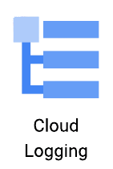

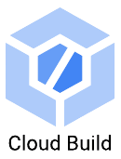
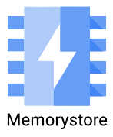

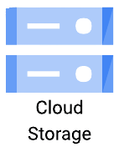
RECOMMENDED GCP & CI/CD SERVICES
Terraform
Cloud Logging
Terraform allows you to define your entire infrastructure as code. This process is repeatable, consistent, and version-controlled. You can roll back infrastructure changes by reverting a commit.
.
Track what’s happening across all your virtual desktops, admin tools, and supporting services. Essential for security, troubleshooting, and operational excellence.
Cloud Build
Redis
Automates the software release process. It automatically builds, tests, and deploys applications whenever code changes, ensuring consistent and reliable deployments.
Redis is like your lightning-fast clipboard—great for temporary, high-speed data access.
Cloud Storage
Provides a highly durable, secure, and scalable object storage for backups and other data. Offers a simple, automated, and off-site solution for data protection.
Caches frequent queries and dashboard data, accelerating web-based admin dashboards and reducing load on backend services

Slide 11

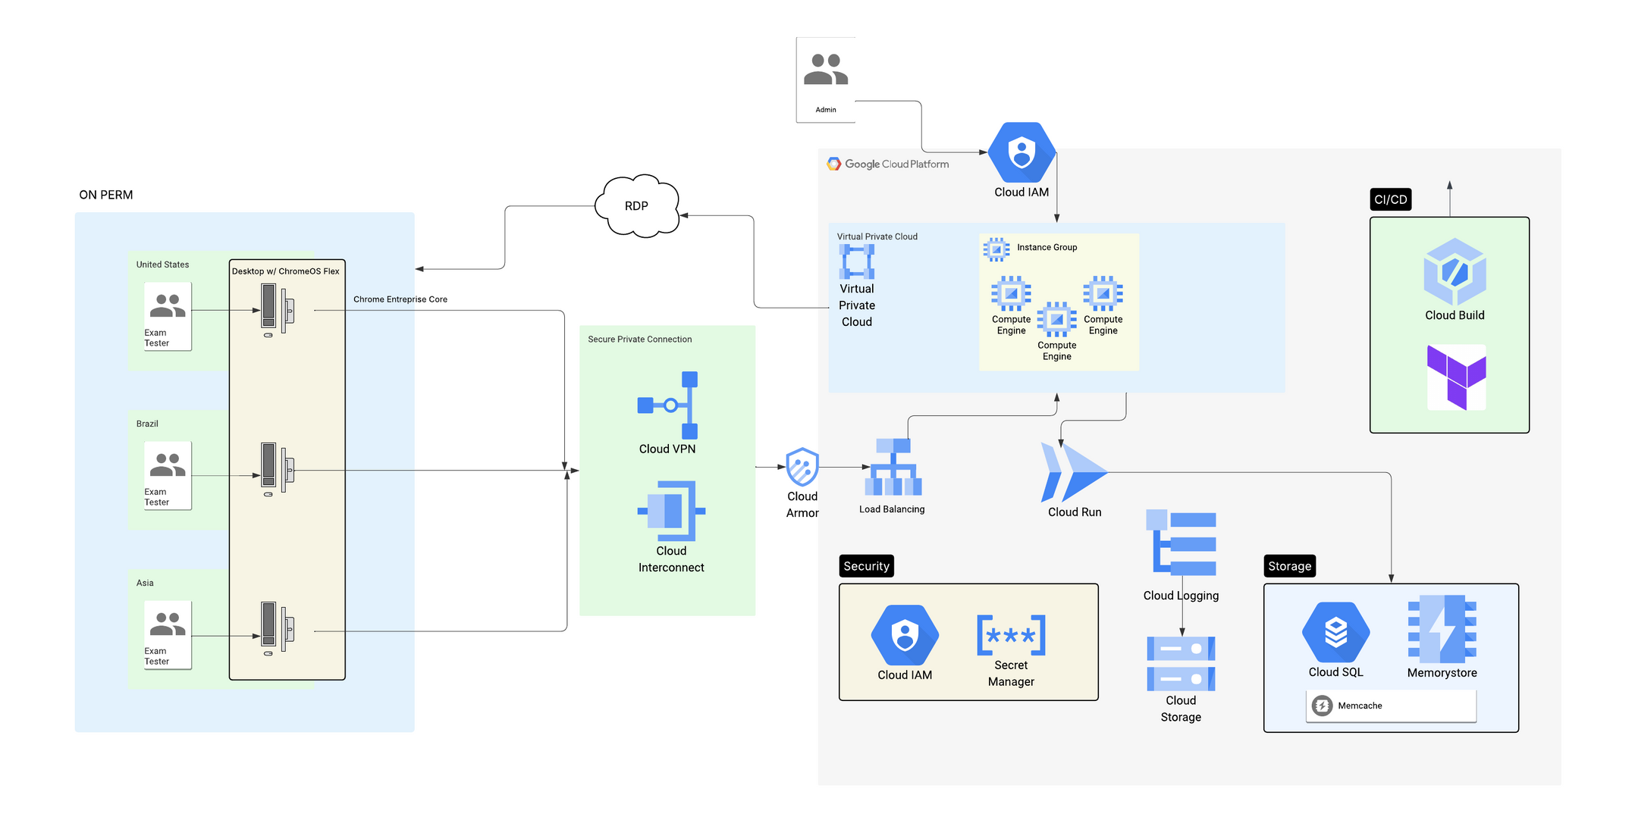
FUTURE STATE | INFRASTRUCTURE

Slide 12
FUTURE STATE | DISADVANTAGES
Dependency on Specialized Skills
The architecture shifts the required skills from general VMWare/Windows administration to more specialized competencies in GCP, Terraform, Cloud Run, and DevOps practices. Finding and retaining this talent can possibly prove to be a challenge and increases ongoing personnel costs.
Subscription and Licensing Costs
This strategy introduces new recurring costs that appears to not have been present in the current architecture. Making use of introductory discounts, sustained use contracts, and scale to zero strategy for compute resources can help with operational overhead however a fiscal plan is now needed which could require addtional personal and outside auditing.
Vendor Lock-In to Google Cloud
The architecture is built deeply on GCP-native services. While this provides great integration, it can make possible future migrations a significant and costly undertaking.

Slide 13
THANK YOU

